Slide 1
Journeys towards effectiveness—how foundations can do good, better
Tris Lumley
Head of Development, New Philanthropy Capital

Slide 2
What is effectiveness?
“Independent foundations have an unique role to play… Relatively unconstrained by the absence of a profit motive, political imperatives or fundraising necessities, foundations have a responsibility to maximise their independence for the public good.”
Clare Thomas MBE, Chair—Association of Charitable Foundations
“Effective here is defined as achieving the ends which a foundation has set for itself. (Though, given the freedom of foundations generally to create their mission, this also implies the ability of a foundation to set itself worthwhile, meaningful goals).
David Cutler, Director—Baring Foundation
The effective foundation—A literature review, Baring Foundation, 2009
Notes:
An alternative picture of effectiveness – it’s about fusing the heart and the head successfully
Do what you’re passionate about
But do it well

Slide 3
What is effectiveness?
Are you getting to your destination?
It is possible to judge how well you’re doing
…but it depends where you’re starting from

Slide 4
Funders are part of a cycle
Notes:
Is it about telling stories about how you help, inspiring supporters, letting people but into your vision

Slide 5
What is effectiveness?

Slide 6
What is effectiveness?

Slide 7
What is effectiveness?
Achieving change in people’s lives
Addressing real and difficult problems
Changing society for the better
Not just about good news stories
Or just numbers and statistics
About both – doing good, better
Achieving the greatest possible change

Slide 8
Some foundations set out to be at the cutting edge of effectiveness
Notes:
CIFF’s current strategy for children was developed throughout 2008 and began implementation in earnest in 2009. With an overarching devotion to high impact funding for children, there are now three central tenets to CIFF’s approach. The first is clarity around success — articulating clearly the impacts we seek overall and precision around how individual grants provide a highly strategic path to these. The second is the explicit use of data — guiding CIFF’s investments based on facts about where the most salient opportunities for children exist, establishing explicit programme targets premised on existing evidence or a sound hypothesis and measuring ongoing progress towards these objectives and ultimate success with reliable data. The third is active learning and adaptation of strategy within each programme, as well as within CIFF, to better optimise impact. ... CIFF recognises that our approach is a substantial divergence from the norm of development funding. The truth is that implementing this strategy is proving exciting, challenging and, often, uncomfortable. We recognise many outside the organisation are skeptical that a donor can successfully marry the acumen and discipline of the private sector with the best thinking and evidence of what works in development. ... Our hope is that CIFF’s journey will be useful for all who aim to make development more impactful.

Slide 9
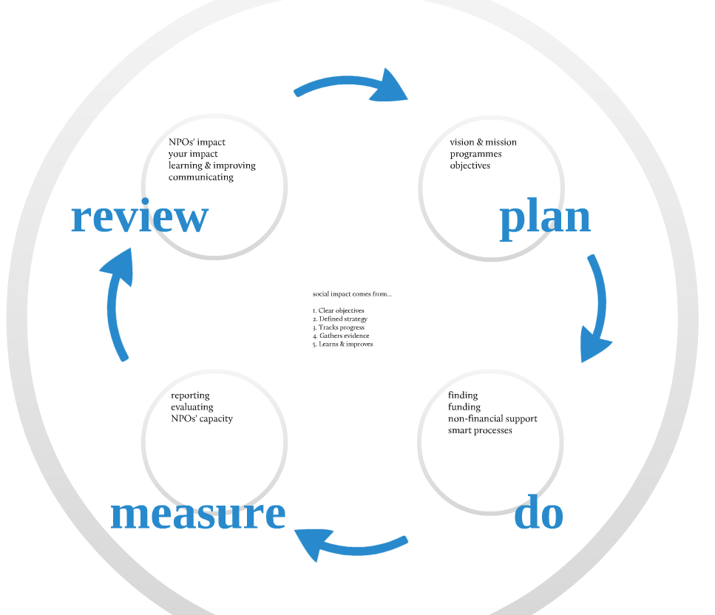
What is an effective foundation?

Slide 10
But do you need to aim to create systemic change to be effective?
What does effectiveness mean if you’re a small foundation, or individual donor?
There are different paths towards effectiveness, depending on where you start from
But there is a problem you can’t ignore
…doing good is NOT good enough

Slide 11
Why effectiveness matters
If you’re not focused on effectiveness
At worst, you risk doing harm
At best, you miss opportunity to do most good

Slide 12
A family foundation began its journey by experimenting with what worked
Notes:
What worked for the foundation – passions, interests, what felt right
What worked in terms of social impact – driven by NPC’s due diligence, proportionate reporting
Comprehensive review after the first cycle, leading to narrowing down focus areas, increasing investments, increasing engagement

Slide 13
A venture philanthropy foundation strengthens effective NPOs

Slide 14
The Gates Foundation works to eradicate polio globally

Slide 15
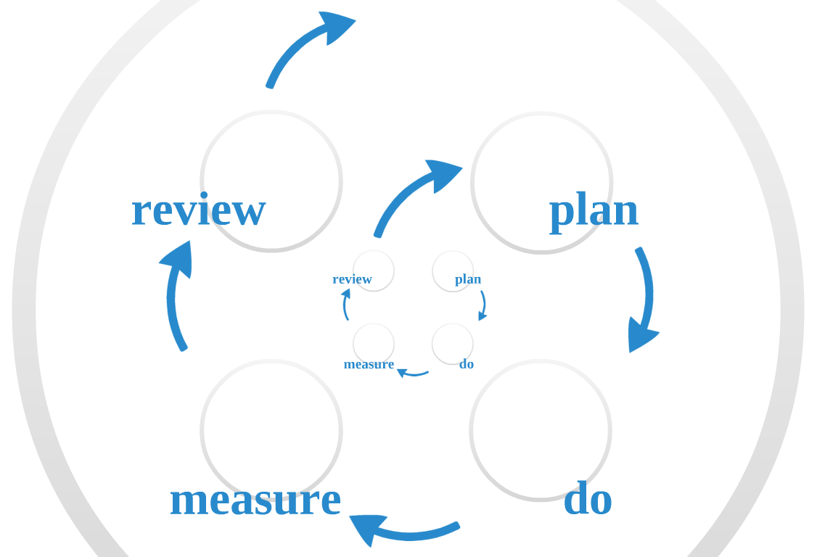
Foundations’ journeys towards greater impact and effectiveness

Slide 16
You don’t have to be the Gates Foundation to be effective
Start from your objectives
…and where you are today
Decide whether you care about effectiveness
Implement practices that
Seek out effectiveness (in the NPOs you support)
Build your effectiveness

Slide 17
What does effectiveness mean for foundations?
Answer the five questions to focus on your effectiveness
What’s the problem you’re trying to address?
What do you do to address it?
What are you achieving?
How do you know?
How are you learning and improving?

Slide 18
What does effectiveness mean for foundations?
To answer the questions you’ll need
Clear objectives
Defined strategy to achieve them
Track progress towards them
Gather evidence of progress/impact
Review, learn, improve and communicate

Slide 19
Effectiveness means…
Clear objectives
Foundation’s vision & mission
Defined programme areas
Defined strategy to achieve them
Making donations?
Playing active, public role as foundation?
Strengthening NPOs & sector?

Slide 20
Effectiveness means…
Defined strategy
Identify NPOs aligned with objectives
Donations to effective NPOs
Appropriate type of funding
Support to improve NPOs?
Smart processes

Slide 21
How to identify effective NPOs
Research to set context
Scan to identify shortlist
Application/due diligence process to assess effectiveness
Sector research
Needs; Opportunities for foundations;
Effective approaches; Evidence base
Identify prospects
NPOs delivery best approaches
Assess effectiveness
Select NPOs

Slide 22
What is an effective NPO?

Slide 23
How do foundations identify effective NPOs?
Proactive research
Application process looks for evidence of
Theory of change
Objectives
Measurement framework
Evidence of impact

Slide 24
Effectiveness means…
Track progress
Reporting framework designed to help NPOs capture what they need on impact
Gather evidence of progress/impact
Big picture—is the needle moving?
NPOs’ impact
Foundation’s impact

Slide 25
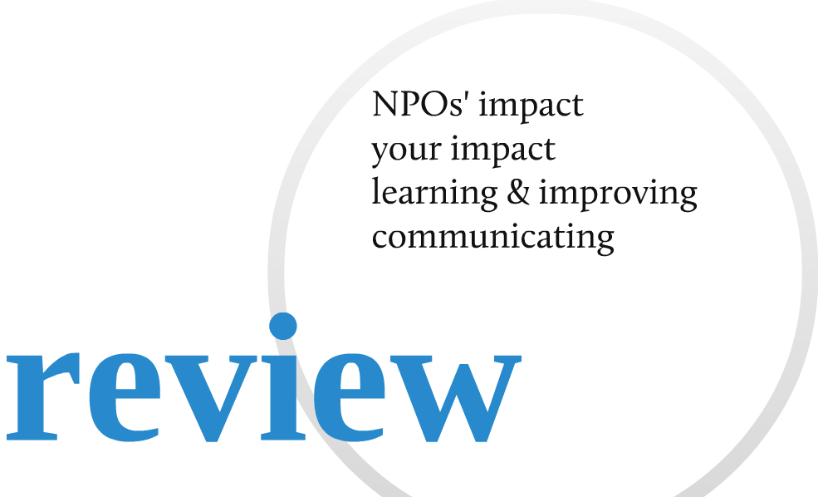
Effectiveness means…
Review, learn, improve & communicate
Are foundation’s objectives being met?
How can the approach be improved?
How can NPOs improve?
Communicating foundation’s impact

Slide 26
If you take effectiveness seriously, how can you get started?
Review your approach
Get help with
Planning – sector research, identifying NPOs
Funding – advice on grant-making, providing support
Measuring – your approach, reporting by NPOs
Reviewing – evaluating, learning & communicating
Talk to others
Who are your peers, and what can you learn/share?

Slide 27
Tris Lumley New Philanthropy Capital
tlumley@philanthropycapital.org
tris.lumley (skype)
www.philanthropycapital.org

