Slide 1

Maximum Philanthropy:
“Are Some Causes Objectively
Better than Others?”
Dr. Jamie Levine Daniel
Dr. Leslie Lenkowsky
February 16, 2017

Slide 2
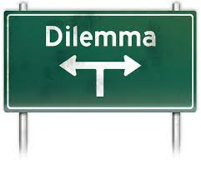
The Problem
Philanthropic resources limited
“Needs” are numerous
Donations reflect individual preferences
Pluralism vs. unitary approach to public interest

Slide 3

The “Effective Philanthropy” Movement
Philanthropy should achieve the “greatest good for the greatest number”
  Peter Singer
  Give Well
  Robin Hood Foundation
  “Strategic philanthropy”
  Guidestar et. al.
  Abdul Latif Jameel Poverty
  Action Lab (MIT)

Slide 4

This session
Goals
  1.Debate the pros and cons of “effective philanthropy”
  2. Examine some concerns of Israeli philanthropy in this context
  3. Draw conclusions that will be useful to Israeli philanthropists, non-profits, and public officials
  PARTICIPATION IS ESSENTIAL!!!!

Slide 5
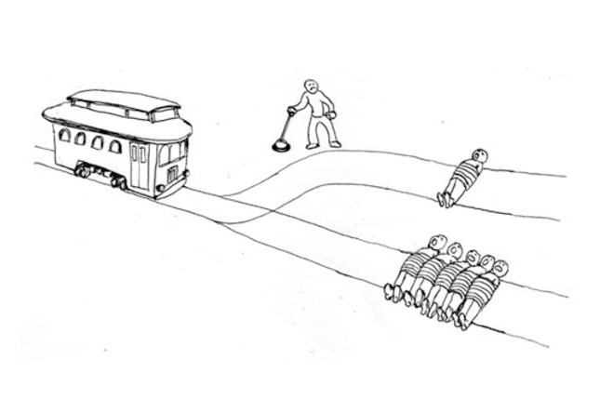
The “trolley problem”

Slide 6
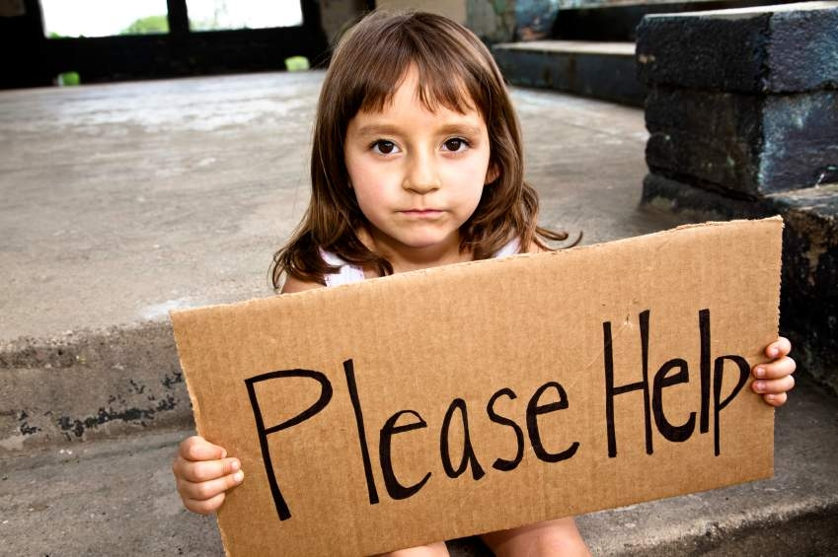
Helping the poor
Over 3 billion people living in poverty
  About 1 billion children live in poverty
  Poverty-rate approaching 50%
  Poverty = $2.50 per day
Poverty rate in Israel: 21.7%
  Child poverty rate: 30%
  Ultra-Orthodox: 54.3% of families
  Israeli Arabs: 52.6%
  Poverty = $2125 per month (8086 NIS)
What is a philanthropist to do?

Slide 7
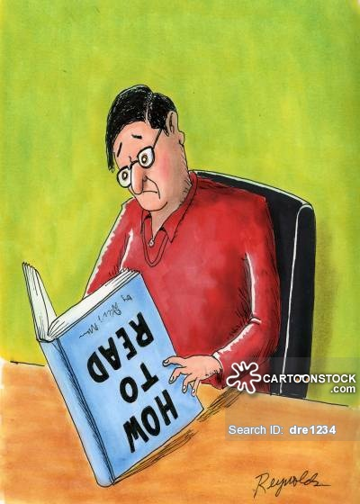
Education
775 million adults lack minimal literacy skills
  122 million are young people
  17% of world’s adult population
  2/3rds are women
In Israel, 97.8% of people are literate
  96.8% of women
  Literacy = able to read and write at age 15
What is a philanthropist to do?

Slide 8

Hunger
795 million people in world
do not have enough food
  12.9% of world is undernourished
  Nearly 1 in 4 people in sub-Saharan Africa are malnourished
Israel: about 5% of population is considered undernourished (FAO figures)
  CBS figures: 16% of Israelis give up food at least once
  37% of Arabs, 13% of Jews
  33% of Ultra-Orthodox, 14% religious, 8% secular,
What is a philanthropist to do?

Slide 9
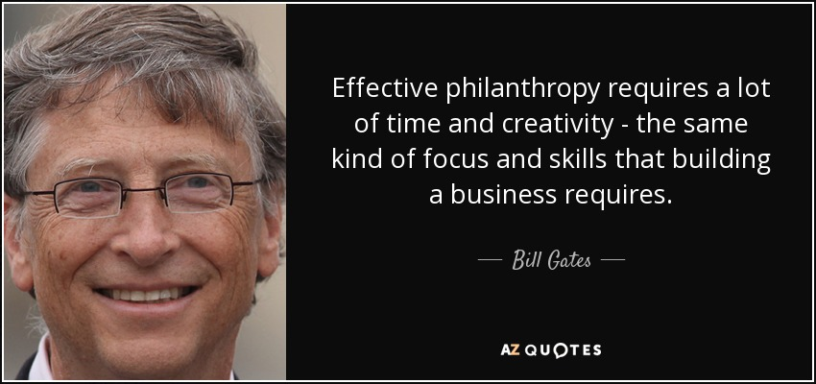
How to be an effective philanthropist
Identify the most important problems
Focus on problems where you can make the most difference
Use methods that get the
biggest bang for the buck
Manage by results (and don’t be
deceived by counterfactuals)
Spend as much as you can as soon as you can

Slide 10
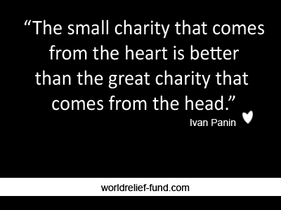
How to be a worthy philanthropist
Identify problems that are personally meaningful
Focus on what one knows
Don’t expect to change the world
Be modest about measuring impacts
Balance short-term and long-term

Slide 11
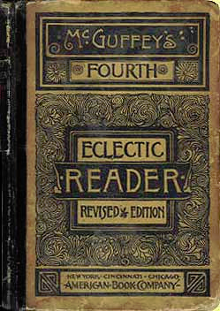
True and false philanthropy
From McGuffey’s Eclectic Fourth Reader, 1848

