Slide 1


PHILANTHROPY:
THE BIG PICTURE
Dr. Leslie Lenkowsky
Professor Emeritus of Public Affairs
and Philanthropic Studies
February 15, 2017

Slide 2
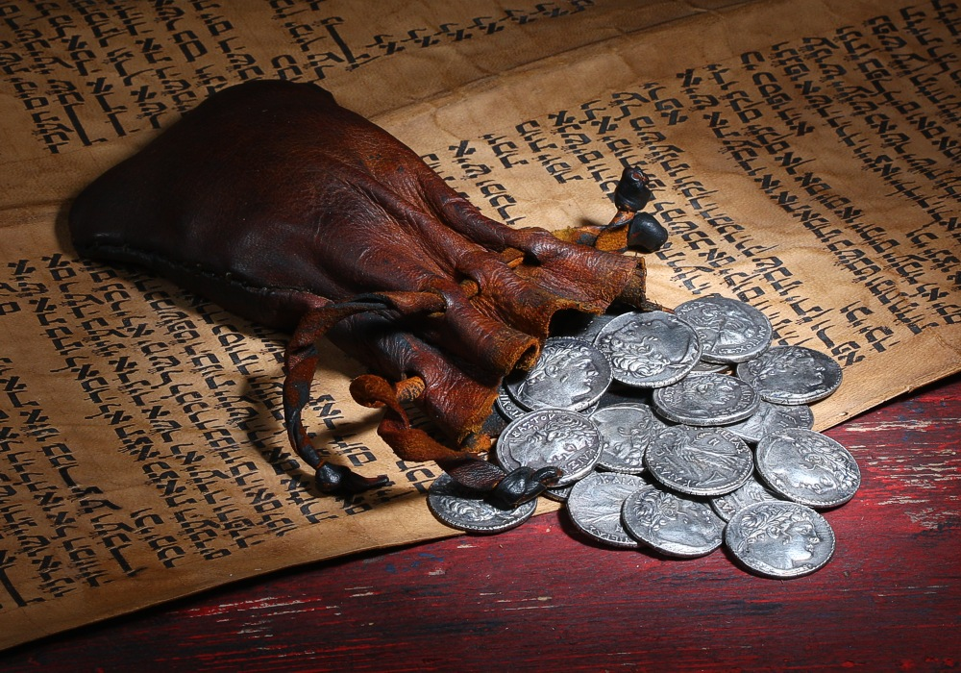
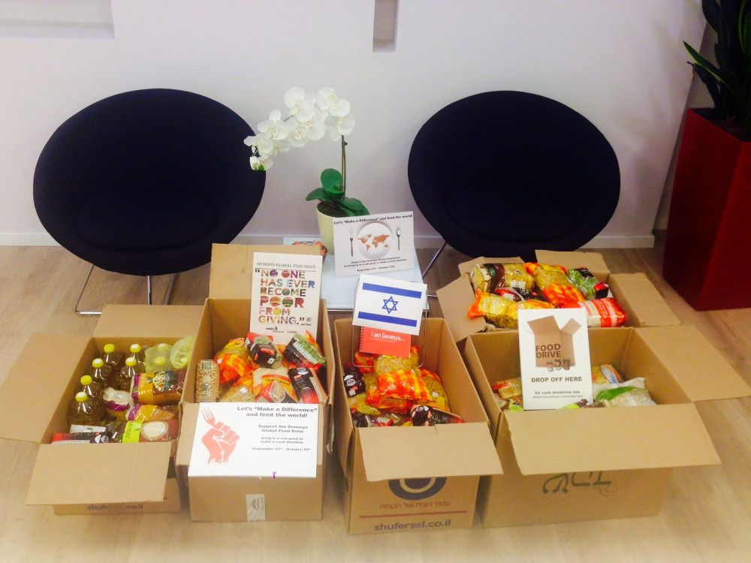
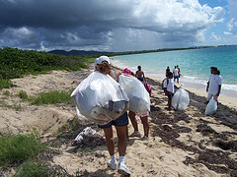
Understanding Philanthropy
Philanthropy: Donation of money, time, or merchandise for the public good
Notes:
Distinguish charity from philanthropy
Voluntary vs. taxes vs. earned income
For needy vs. for other purposes

Slide 3
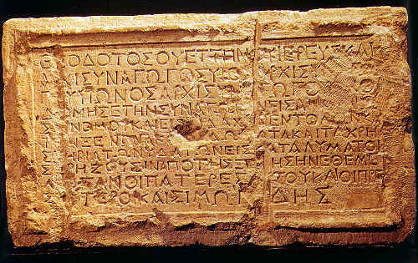
An Old Practice
The Theodotus Stone (1st century)
Notes:
Religious roots: Yom Kippur
Maimonides: “ladder of giving”
Secularization and professionalization

Slide 4

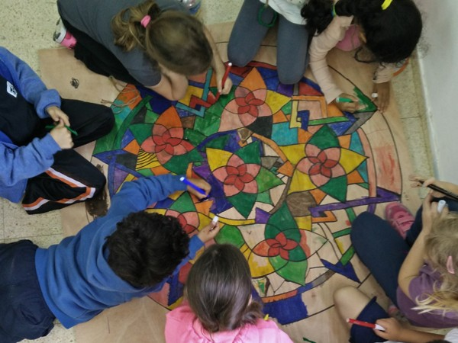
Who Gives?
Individuals
  Wealth
  Gender
Institutions
  Federations
  Foundations
  Corporations
Notes:
Disapora Giving
Motives
Time vs. money

Slide 5


Who Receives?
Needy individuals
Charities (NGO’s)
Advocacy Groups
Hybrids
Notes:
What is a charity? Elizabethan Law
Receivers can be givers
Social enterprises/Israel bonds

Slide 6

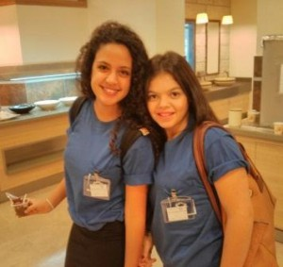

The role of government
Rule-maker
Regulator
Funder
Competitor
Notes:
Deductions, exemptions, other benefits
Reporting rules, sources of funds, activities
Health care, education

Slide 7
A World of Giving
Notes:
Based on surveys: percent who donate money

Slide 8
Notes:
Differences between different types of behaviors
Iraq, Libya, Kuwait, Somalia, UAE lead in helping a stranger;
Myanamar, Indonesia, Australia, Malta, New Zealand in donating money.
Turkmenistan, Myanamar, Indonesia, Sri Lanka and US in volunteering.

Slide 9
Notes:
Consistent over time

Slide 10

Where is Israel?
Notes:
More likely to donate money than give time or help a stranger.
Typical of countries with higher GDPs.
Self-reported data

Slide 11
Giving in numbers
Notes:
Source: Charities Aid Foundation, Gross Domestic Philanthropy, January 2016. Data from 2007-15
Israel: 0.6% of GDP, Central Bureau of Statistics Report, Philanthropy of Israelis, 2009-11. US put at 1.7%
Does not include monetary value of volunteering

Slide 12
Drivers of giving
Notes:
Israel not included in these figures.
Tax rates are correlated with helping a stranger and volunteering too.

Slide 13
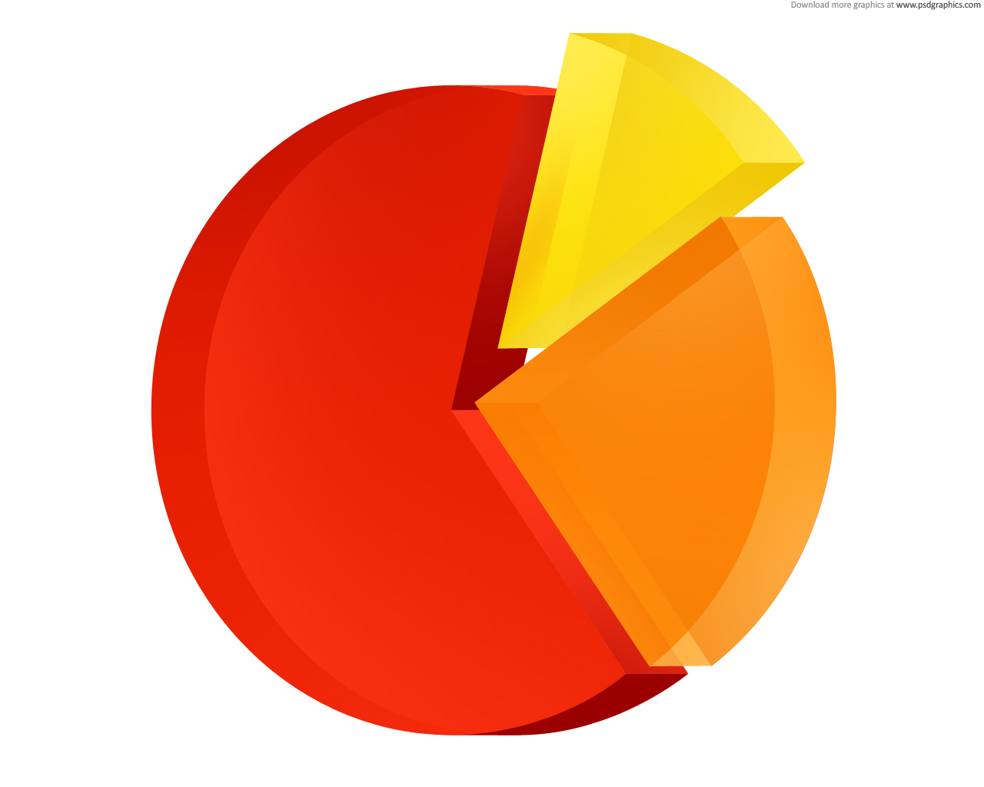
The demand side
Charities have several sources of support:
  Philanthropy
  Government
  Earnings
Types of charities vary in reliance on philanthropy vs. other sources of support
Countries vary by pattern of support
Notes:
Note bequests, income from endowment

Slide 14
Notes:
Salamon et. al., The State of Global Civil Society and Volunteering (UN Nonprofit Handbook), data from 2002 – 2009.
Israel: Philanthropy dominates civic international; government -- health, education, culture; fees – environment, professional, social services

Slide 15
Not just money

Slide 16
Nonprofit sector large …

Slide 17
and Growing
Notes:
Late 1990’s to mid-2000’s. Data not available for Israel.

Slide 18
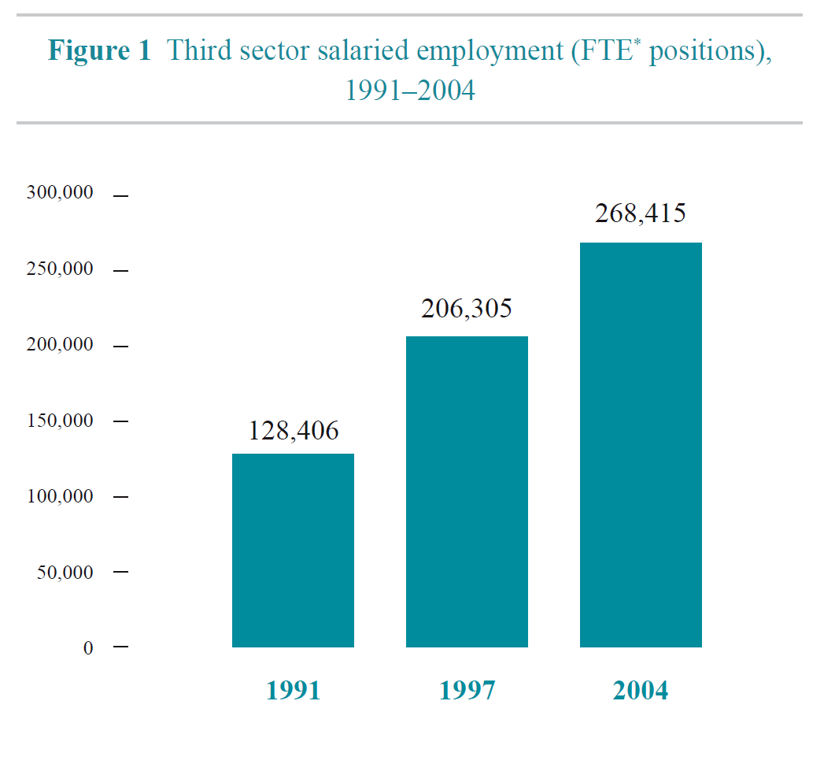
In Israel too
Notes:
Source: Benjamin Gidron, The Israeli Third-Sector: Patterns of Activity and Growth, 1980 – 2007
Accompanied by increase of expenditures. Est. at 11% of GDP. 30% growth between 1997 and 2004.

Slide 19
Public social spending has grown
Notes:
Source: OECD Social Expenditure Update (2016). Rate of growth has slowed down after 2000.

Slide 20
“Private” social spending helps
Notes:
Includes pensions, payments for health and social services, et al. Includes social benefits provided by NGO’s..

Slide 21
“American exceptionalism”
Notes:
Salamon et. al., The State of Global Civil Society and Volunteering (UN Nonprofit Handbook), data from 2002 – 2009.

Slide 22
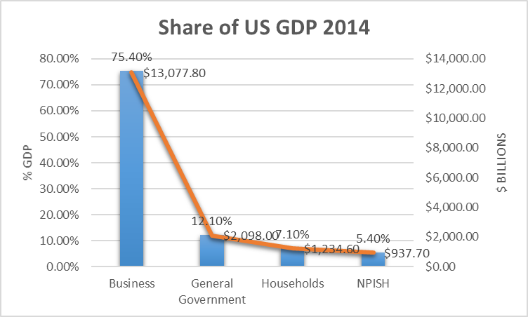
Importance of US Non-Profits

Slide 23
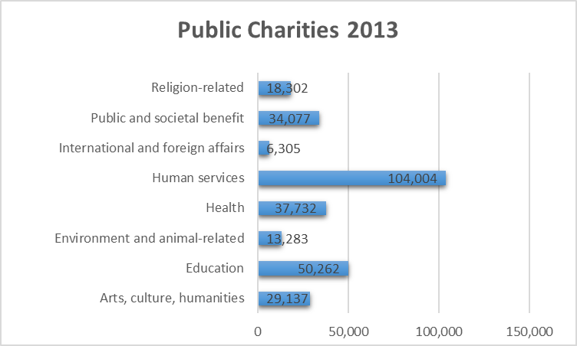
What they do
Notes:
Reporting public charities – 293,102 -- are about thirty percent of total registered public charities, 1.179,739
Not included: smaller charities, religion, informal groups

Slide 24
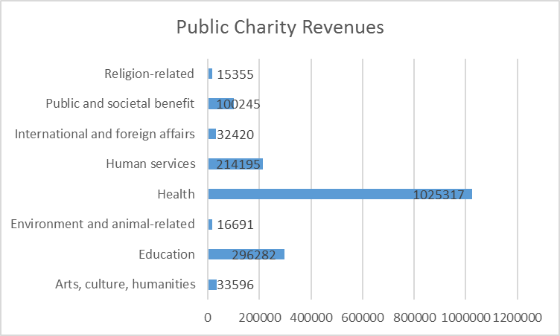
Revenues
Notes:
Millions of dollars; only reporting organizations

Slide 25
Sources of support for US nonprofits
Notes:
Urban Institute, The Nonprofit Sector in Brief, 2015
Excluding hospitals: 15.5%, 38.6%, 24.3%, 14.1%, 5.5%, 2.1% respectively

Slide 26
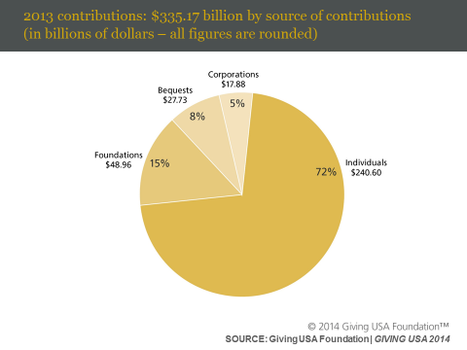
Givers
Notes:
Source: Giving USA, 2014
Giving by individuals comprised 72 percent of total giving in 2013.
Giving by foundations—which includes grants made by independent, community, and operating foundations—amounted to 15 percent of all gifts made in 2013.²
Giving by bequest accounted for 8 percent of all gifts made in 2013.
Giving by individuals, bequest, and family foundations amounted to an estimated 87 percent of total giving in 2013.³
Giving by corporations comprised 5 percent of total giving in 2013.

Slide 27
Israeli Givers
Notes:
Philanthropy of Israelis, 2009-11

Slide 28
American foundations

Slide 29
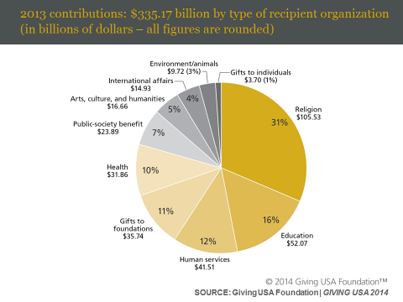
Recipients
Notes:
Giving to religion was flat (-0.2 percent) between 2012 and 2013, with an estimated $105.53 billion in contributions. Inflation-adjusted giving to the religion subsector declined 1.6 percent.
Giving to education is estimated to have increased 8.9 percent between 2012 and 2013, to $52.07 billion. Adjusted for inflation, giving to education organizations increased 7.4 percent.
Giving to human services increased by an estimated 2.2 percent in 2013, totaling $41.51 billion. Adjusted for inflation, giving to human services organizations increased by 0.7 percent.
Giving to foundations is estimated to have declined by 15.5 percent in 2013, to $35.74 billion. Adjusted for inflation, giving to foundations declined 16.7 percent.
Giving to health organizations is estimated to have increased 6.0 percent between 2012 and 2013 (an increase of 4.5 percent, adjusted for inflation), to $31.86 billion.
Giving to public-society benefit organizations increased by an estimated 8.5 percent between 2012 and 2013, to $23.89 billion. Adjusted for inflation, giving to public-society benefit organizations grew 7.0 percent.
Giving to arts, culture, and humanities is estimated to have increased 7.8 percent between 2012 and 2013, to $16.66 billion. Adjusted for inflation, giving to the arts, culture, and humanities subsector increased 6.3 percent.
Giving to international affairs is estimated to be $14.93 billion in 2013, a decrease of 6.7 percent from 2012. Adjusted for inflation, giving to international affairs organizations declined by 8.0 percent.
Giving to environmental and animal organizations is estimated to have increased 7.5 percent between 2012 and 2013, to $9.72 billion. Adjusted for inflation, donations to the environment/animals subsector increased 6.0 percent.
Giving to individuals is estimated to have risen 1.4 percent between 2012 and 2013, to $3.7 billion. The bulk of these donations are in-kind gifts of medications to patients in need, made through the Patient Assistance Programs of pharmaceutical companies’ operating foundations.

Slide 30
Israeli recipients
Notes:
Philanthropy of Israelis, 2009-11
Diaspora more likely to give to education, philanthropy; Israelis to social services and religion

Slide 31
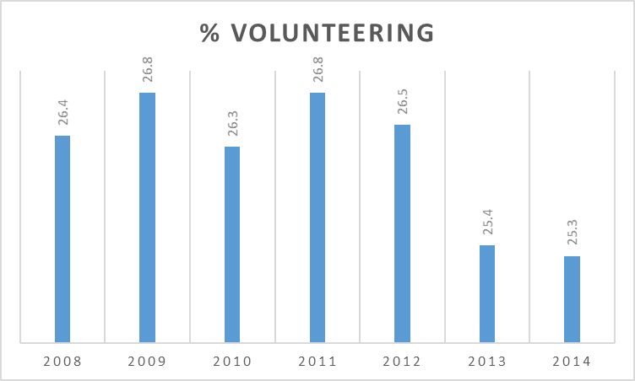
Volunteering
Notes:
The Nonprofit Sector in Brief, 2015
Median hours 50 -52
62-63 million adults

Slide 32
Activities

Slide 33
The Future?
Notes:
US based on Treasury department files of estates; Boston College
Recession had little effect. 1998-2052, 2% growth: $25 trillion to heirs; latest:

Slide 34
Impact Investing

Slide 36
Notes:
2015: 7551, $15 trillion
2016: 11722, $17.7 tillion

Slide 37
The role of corporations
Notes:
59 companies, Fortune 500

Slide 38
Notes:
International aid: .7 % of GNI is international standard. Only Scandinavian countries exceed it.

Slide 41
What have we learned?
Philanthropy is extensive around the world and takes several forms.
Countries differ in reliance on philanthropy to promote public good.
Government policies affect philanthropy a lot.
United States has traditionally relied more on philanthropy than most other countries.
Israel looks like U.S. in some ways, but government plays a larger role.
What is the future of philanthropy in Israel? What would help?
Notes:
Mention China, India
Importance of political, economic, cultural and social factors in differences
Don’t overstate US philanthropy

Slide 42
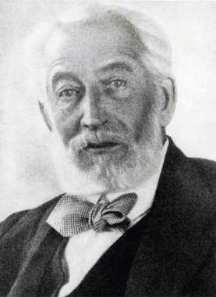

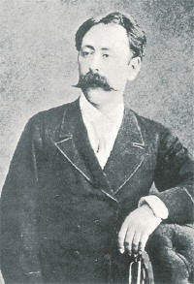
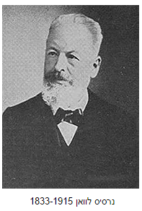
רקע לנתונים על
פילנתרופיה בישראל
לצדקה שורשים עמוקים ביהדות, בנצרות ובאסלאם
מתמיכה בישוב היהודי לתמיכה במדינת ישראל
פילנתרופיה מקומית נתפסת כהחצנת עושר וכמשחררת את המדינה מאחריותה
המגזר העסקי – שחקן חדש יחסית (גם חברות וגם יזמים חברתיים)
נותנת מענה לצרכים חברתיים שהממשלה אינה נותנת להם מענה מספק
אדמונד רוטשילד
הברון הירש
נרסין לוון

Slide 43
רגולציה של תרומה
סעיף 46 לפקודת מס הכנסה
זיכוי ממס הכנסה על 35% מגובה התרומה עד תקרה של 9 מיליון שקל, ועד 30% מההכנסה החייבת במס לאותה שנה.
עסקים וחברות נהנים מזיכוי בגובה מס החברות בשנה שניתנה התרומה (25% ב- 2016)
רק 22% מכלל התרומות בישראל מדווחות לצורך זיכוי ממס
MONGO
קרנות כעמותות
חסרים פילנתרופים מפותחים כמו בארה"ב – קרן משפחתית, DAF, CRT, LLC
חסר במסד נתונים

